Slide 1
Team Details
Team Members: Team Name: GROTO
Mohammed Amaan Ali Siddiqui amaansiddiqui1999@gmail.com
B Mahendar Reddy mahendharr22@gmail.com
Bala Prem Raj balapremraj123@gmail.com
Banu Sindhu Etikala sindhubunny19@gmail.com
Samreen Begum samreen15102000@gmail.com
Sabrina Shaik sabrina.shaik80@gmail.com

Slide 2
College Code: MGIT Problem Code: SG64
GROTO: Green Route To Our Future
Ministry/organization name: Ministry of Micro, Small & Medium Enterprises
Problem statement: Development of business models for collection and utilization of single use plastics and various other industrial wastes.

Slide 3




Our Aim
Integrating the existing services provided by Government Municipalities & Private Recycle Centers.

Slide 4
We tend to focus on
Collection (Pickup && Delivery)
Utilization (Recycle || Disposal)
Revenue Generation
स्वच्छ भारत
This solution promotes the ideology of
(swacch bharat).

Slide 5



Idea/Solution
Solution: An android application which can search for the nearest public and private associations to collect industrial waste from a household/manufacture industry and further utilize it.
Application Features:
3 users roles supported- Administrator, Scrap Collector, Customer
CUSTOMER - Categorizing waste type for better dealing
- Driver’s Live Location Tracking
- Scheduling Pickup service
ADMINISTRATOR- Authenticated Drivers
- Accepting or Rejecting drivers application
- Add GROTO coins into drivers wallet
DRIVER- Accepting or Requesting a pickup
- Confirming a pickup after the service

Slide 6




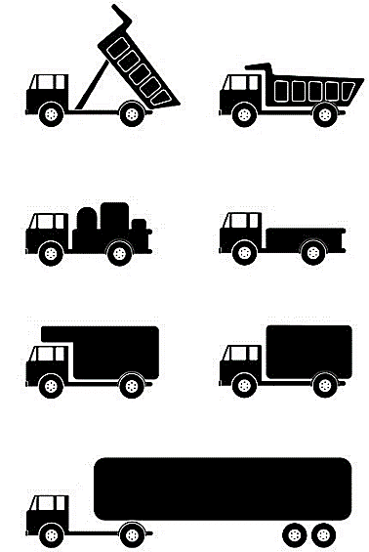

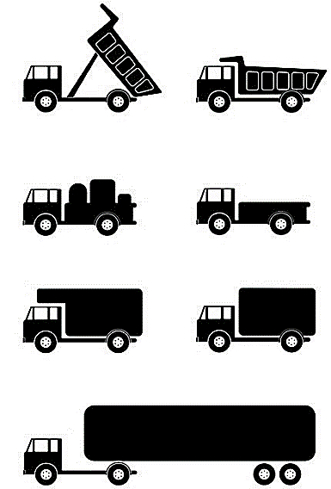
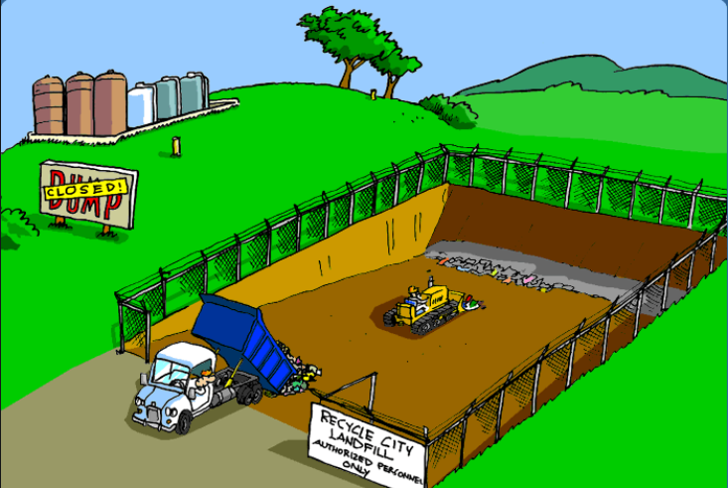

GROTO Customers
if(waste== ble )
Manufacturing Industries
Recycle Centers
GROTO Driver/Scrap Collector
else
House Holds
Municipal Corp

Slide 7
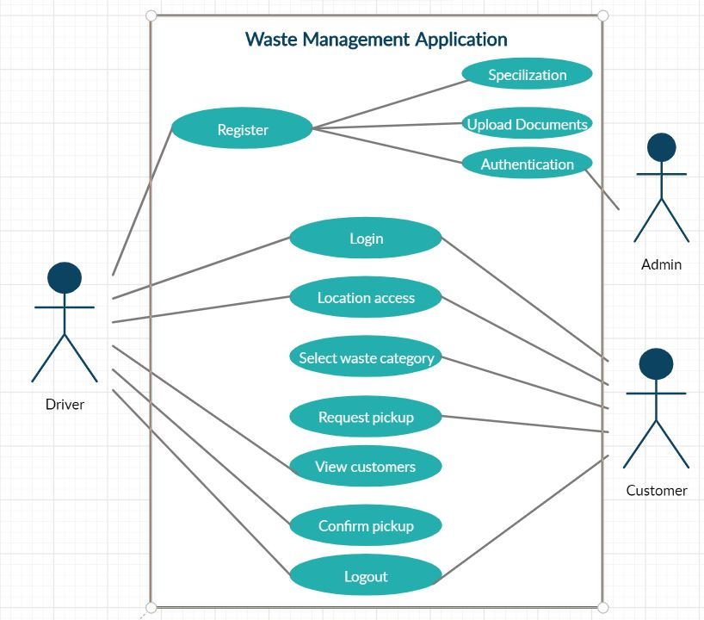
Use case diagram

Slide 8
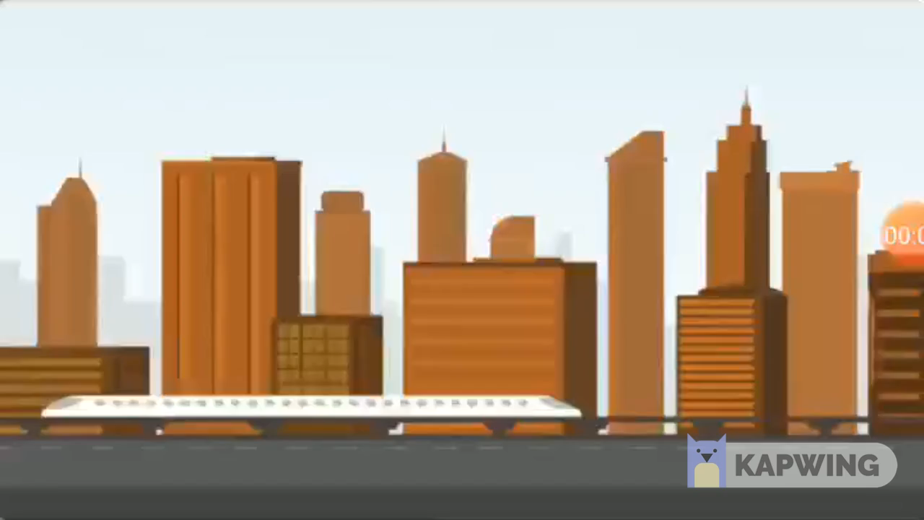

Slide 9


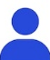
Block Chain
Number of(Admins) >>>Hackers

Slide 10
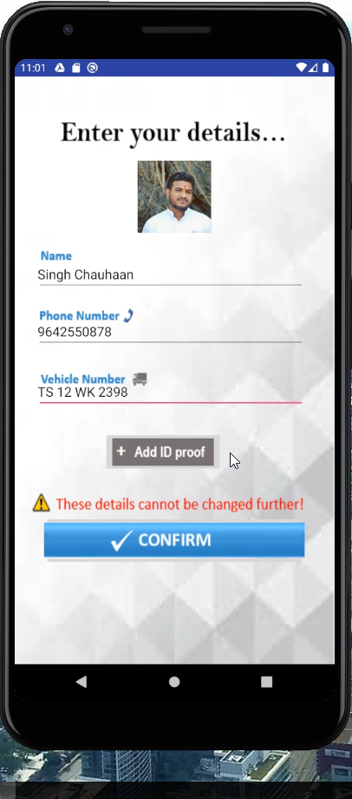
1.Driver Registration
2.Administrator Accepting the driver application(MUTUAL VOTING SYSTEM)

Slide 11
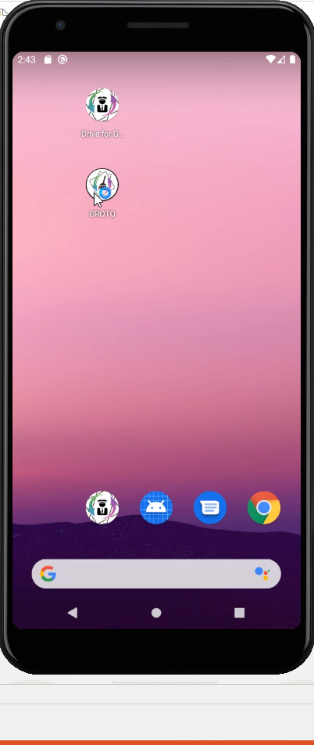
Customer pick up scheduling Driver Confirmation

Slide 12
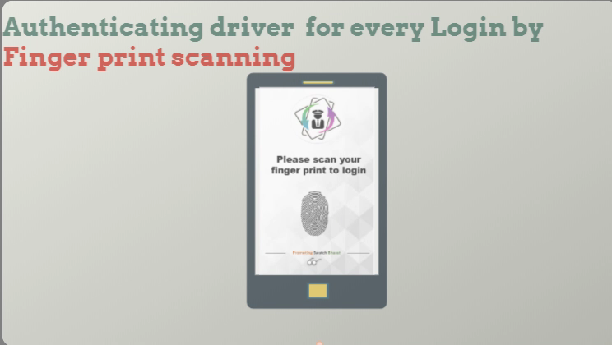
Finger Print Scanning & Image Recognition & OTP Verification – 3 Factor Authentication

Slide 13
Technology Stack : Application
Languages: XML, JavaScript, Java for Backend
Databases: Google firebase
Back-End Technology: Block Chain
Operating System: Android KitKat and above
Hardware Requirements: Android smartphones
Economical Feasibility: Free and easy to access
Front-End Development Tools: UI design tools
Back-End Development Tools: Android studio

Slide 14

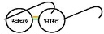


GROTO Coin- Centralized Currency
House Holds
ADMIN
GROTO Customer
GROTO Driver/Scrap Collector
0
Wallet: 0
Wallet: 0

Slide 15
ML based Website
Features: - Detailed report of state wise Waste Generation & Waste Processing .
- Report of Per Day Waste Generation by each State.
- % of Scrap generation by various types of Manufacturing Industries.
- Waste quantity generation prediction for future years.
- Live Visualization of Data from API after Classification
Technology Stack
Front End Languages : Java script, Html, Bootstrap
Back-End Languages: Python
ML Model Types: Regression , Classification & Clustering

Slide 16
ADVANTAGES
Decentralized and unhackable database-SECURITY
Transparency
Job Opportunities
Generates Revenue
Waste material categorization available
Applicable to household waste too
Vehicle specifications available

Slide 17
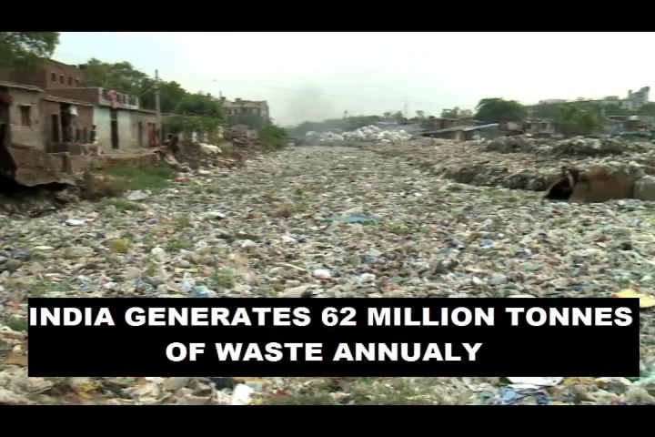

Slide 18
Thank you

